Slide 1
IoT-based Climate Controller
In-house training project by
Atmaja Chowdhury
Roll no.-03414802814
Shubham Aggarwal
Roll no.-02014802814
Under the guidance of our faculty in-charge
Prof. P.K. Choudhary

Slide 2
Objective
To create an IoT-based climate controller using ESP8266 and DHT11 sensor

Slide 3
Elements of IoT-based Climate Controller
Arduino Uno Microcontroller
ESP8266 Wi-Fi module
DHT11 module
Single-relay switch

Slide 4
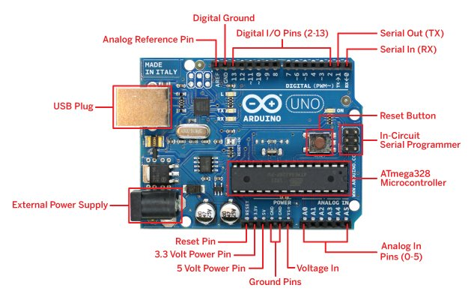
Arduino
Arduino/Genuino Uno is a microcontroller board based on the ATmega328P .
It has 14 digital input/output pins (of which 6 can be used as PWM outputs), 6 analog inputs, a 16 MHz quartz crystal, a USB connection, a power jack, an ICSP header and a reset button.

Slide 5
Arduino consists of both a physical programmable circuit board (often referred to as a microcontroller) and a piece of software, or IDE (Integrated Development Environment) that runs on our computer, used to write and upload computer code to the physical board.

Slide 6
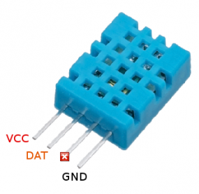
DHT11 Sensor
DHT11 digital temperature and humidity sensor is a composite Sensor contains a calibrated digital signal output of the temperature and humidity.
It has a dedicated digital modules collection technology and temperature and humidity sensing technology, to ensure that the product has high reliability and excellent long-term stability.

Slide 7
Applications
Dehumidifier
testing and inspection equipment
consumer goods
data loggers
weather stations
home appliances
humidity regulator
medical and other humidity measurement and control.

Slide 8
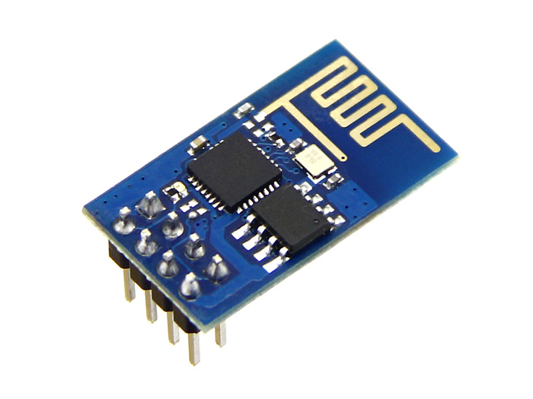
ESP8266-11 Module
The ESP8266 is a low-cost Wi-Fi chip with full TCP/IP stack and MCU (microcontroller unit) capability. . The ESP8266 is capable of either hosting an application or offloading all Wi-Fi networking functions from another application processor.

Slide 9
Features
. Its high degree of on-chip integration allows for minimal external circuitry, including the front-end module, is designed to occupy minimal PCB area.
It contains a self-calibrated RF allowing it to work under all operating conditions, and requires no external RF parts.

Slide 10
Relay Switch
A relay is an electromagnetic switch which is used to switch High Voltage/Current using Low power circuits. Relay isolates low power circuits from high power circuits. It is activated by energizing a coil wounded on a soft iron core. A relay should not be directly connected to a microcontroller, it needs a driving circuit.

Slide 11
Working
Obtain real-time data such as temperature, humidity etc. via DTH111 sensor.
Send the data to cloud via Arduino for user access.
Send the data to the app installed in user’s smartphone from cloud.

Slide 12
Compare the real-time temperature with the threshold temperature set in Arduino.
If temperature is greater than the threshold, Arduino microcontroller will send high signal to relay switch and the circuit opens.
If temperature is lesser than threshold, Arduino will send low signal to relay switch and the circuit closes. The device runs,

Slide 13
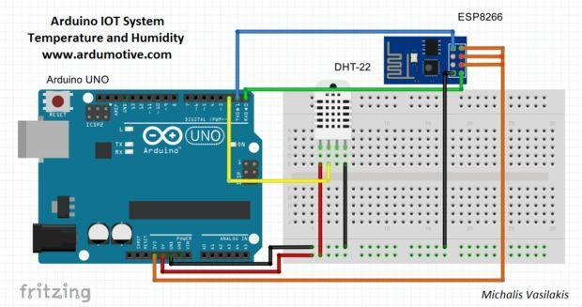
Circuit Diagram

Slide 14
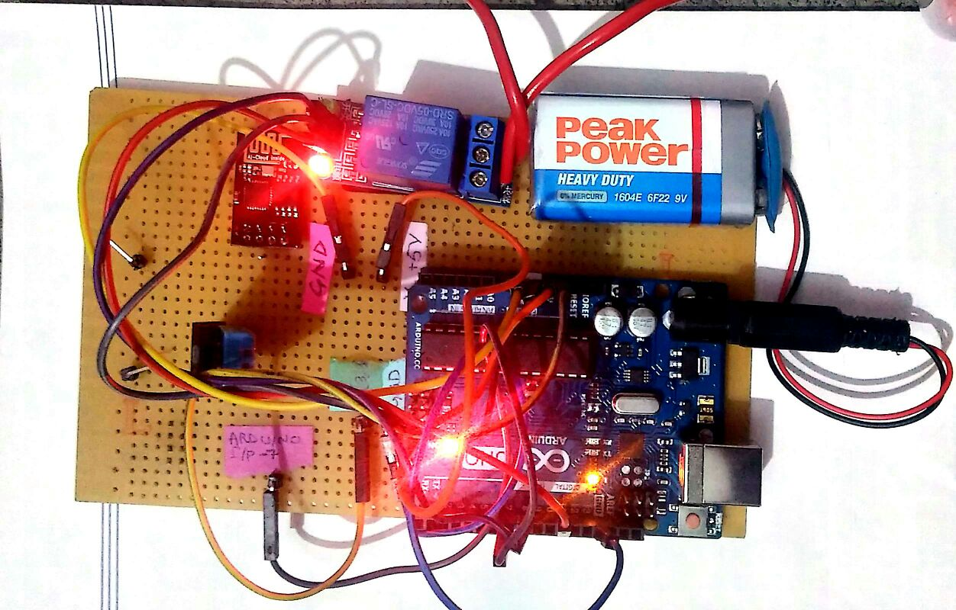
Image of the IoT-based Climate Controller

Slide 15
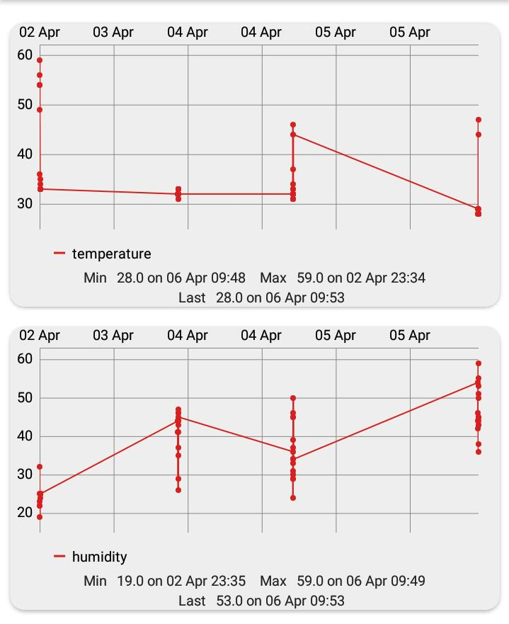
Observations
On the app, we observe the variations in temperature and humidity from 2nd April, 2017 to 5th April, 2017

Slide 16
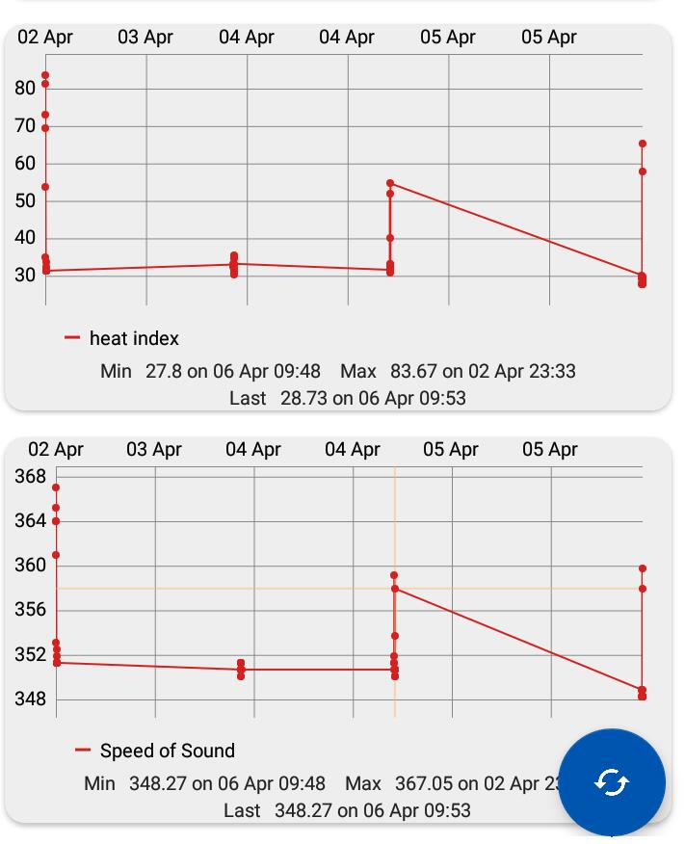
In second set of observations, we see the variation in speed of sound and heat index from 2nd to 5th April, 2017

Slide 17
Result
From this experiment, we have been able to successfully demonstrate a climate controller using a microcontroller and a relay switch. This project, when scaled up to connect various temperature controlling devices can be easily installed at home to automatically control them without human intervention.

Slide 18
Advantages
Some of the advantages of this project are as follows:
The switch can be changed to two-device or multi-device relay switch to control two or more devices simultaneously.
The devices can be switched on/off without any manual intervention.
Real-time data on parameters such as temperature, humidity, speed of sound etc. is available easily.
The climate-controller is inexpensive and scalable, thus making is a viable option to install in every home.

Slide 19
Thank you!

